Slide 1
Thesis Advisory Committee Meeting June 2020
Vincent Baker
Drexel University Department of Physics

Slide 2
Outline
Overview of work
Locally-connected cortical circuits in multiple dimensions: functional relevance of traveling waves
Biological relevance (cortex organization, local connectivity, observed waves)
Summarize previous results, answer wave initiation question from previous TAC
1.5D results
Filtering effect
Reliable transmission
Frequency dependence
2D
Brief intro, stable attractors

Slide 3
Research status
Completed 1-D research by answering question on wave initiation
Answer showed strengths of the approach
Paper drafted, provided for review
1.5D research shows interesting properties of ensembles of columns
Able to encode and transmit sparse representation of population firing rate
Included in paper with 1-D results
Initial 2-D simulations shows traveling wave formation and annihilation, “spiral” waves seen in other simulations, dynamic attractor states
Expect to defend Spring 2021
TODO: Replace with timeline, minimal detail, planned (2) papers (1-1.5 ad 2D)

Slide 4
Overview of problem
What are we doing and why does it matter

Slide 5
Motivation
Scientific question: does the anisotropy and morphology in the cortex have a function
The cerebral cortex is the region of the brain responsible for cognitive functions such as object recognition, spatial processing and attention
Modern experimental methods have revealed much about the structure and organization of the cortex, but we still don’t understand the functional role of cortical organization
The local neuron connectivity in the neuron supports traveling waves of neuron firing
This work proposes functional roles of cortical traveling waves in simple models of neural circuits
TODO: Do 6 and other background first

Slide 6
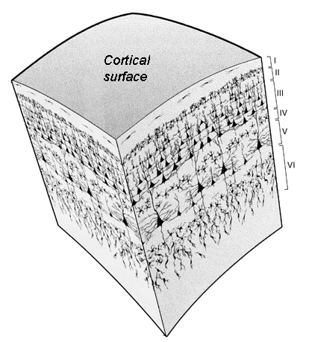
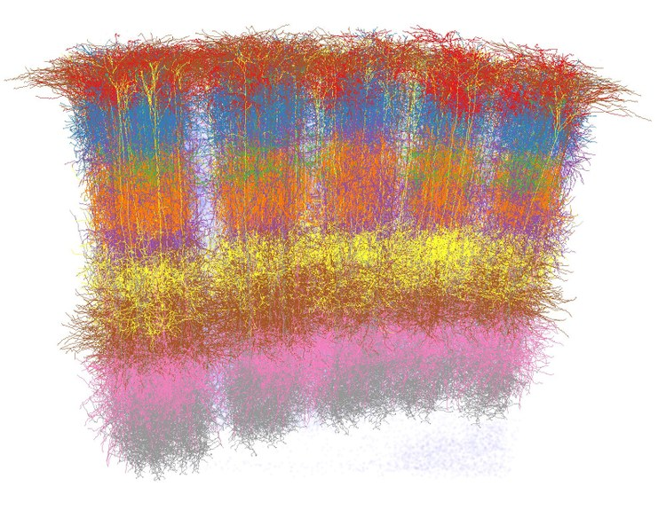
Cortex organization
Cortex has a laminar structure
Columnar structures penetrate the layers
TODO: Replace right image with Peters
Cell-type-specific 3D reconstruction of five neighboring barrel columns in rat vibrissal cortex (credit: Marcel Oberlaender et al.)
The cortex is organized into horizontal layers
Illustration of a density map calculation showing microcolumn organization in the monkey cortex (Cruz et. al.)

Slide 7
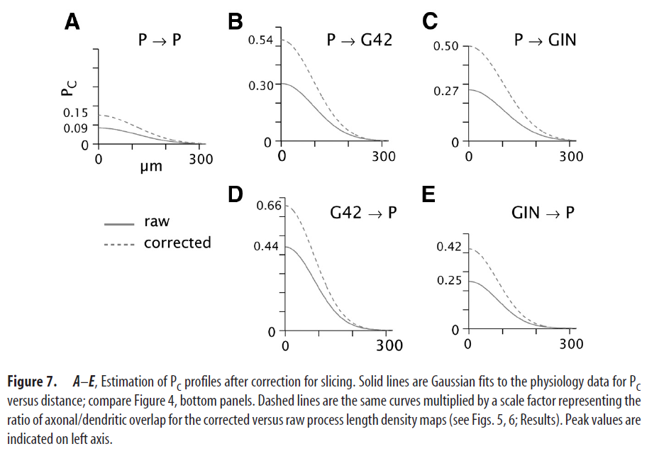
Local connectivity and traveling waves
Most connections in the cortex are between nearby neurons
Local connectivity (left) supports traveling waves of neuron firing (right)
TODO: Start with local connectivity (1 slide), then 1 slide basic neural dynamics (AP is a traveling wave), then 1 slide traveling waves of spikes in a cartoon, then 2-D videos from papers
Propagating waves in the visual cortex
Wu et. al 2008.

Slide 8
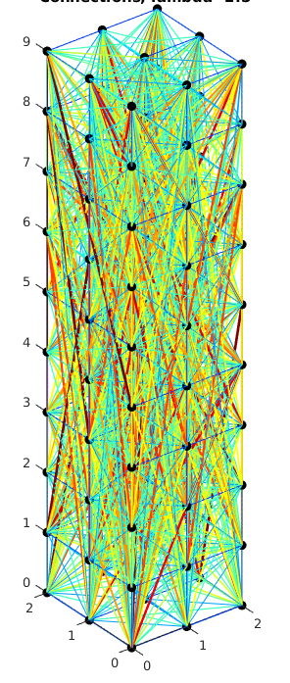
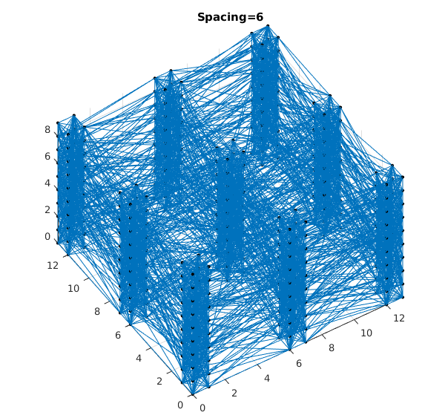
Fundamental structures
1-D columns
1.5-D ensembles of columns
2-D sheets
1.5-D Dynamics, not 1.5D morphology
Needs to relate to scientific question
TODO: Add 2-D picture, use common color scheme for connection length

Slide 9
Proposed roles
1-D structures: Tunable information propagation speed,
1.5-D structures: Reliable encoding and transport of population firing rates
2-D structures: Stable attractor states, spatial processing via traveling waves (to be done)
TODO: Simplify explanation, remove jargon, PopSci explanation of functional roles

Slide 10
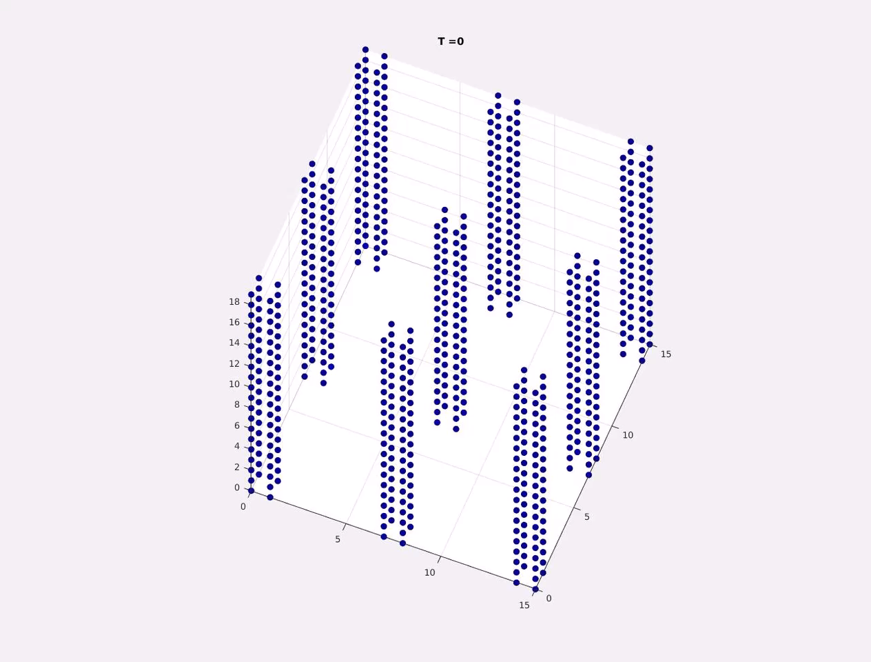
Wave examples
TODO: Add 1-D video
These are RESULTS, move to relevant sections
https://youtu.be/Is8vbyXliV0

Slide 11
Summary of previous work
Answer questions from last TAC

Slide 12
Summary of previous work
Add 3-4 slides from previous TAC
Developed simulation model, higher fidelity neural and synapse dynamics than previous computational studies of traveling waves
Explored traveling waves in 1-D columns: initiation, propagation, annihilation
Unresolved question: why do columns show preferential wave initiation sites ?
Answer: Some inhibitory neurons in the column have a low firing threshold (LTS inhibitory neurons) so are more likely to fire due to background stimulus
These LTS inhibitory neurons can create preferential wave initiation sites through postinhibitory rebound spiking
TODO: Fewer words,

Slide 13
LTS Inhibitory Neurons
Add anti-correlation between wave density and initiation sites
Cortical inhibitory neurons often have lower firing thresholds, this biological observation is incorporated into our neuron dynamic model
Postinhibitory rebound spiking is a phenomenon only observed in neuron dynamics in at least 2 dimensions
To illustrate the phenomenon we created a column with exactly one LTS inhibitory neuron
TODO: Show postinhibitory rebound spiking (membrane potential and dynamics)
TODO: Replace/augment picture with video of this test

Slide 14
1.5-D Results
Ensembles of columns

Slide 15
Population rate encoding
We have demonstrated 1.5-D neural structures can successfully encode and transmit information about the firing rate of a population of neurons
The space between the individual columns (and thus the degree of inter-column connectivity) changes the behavior
A disconnected ensemble does not transmit information as reliably
A moderately connected ensemble reliably transmit firing rate information in a sparse representation with noise filtering
Show column structure and video of firing
Phrase everything in terms of the question: how does morphology influence functional role of traveling waves?

Slide 16
Experiment
Placeholder, this slide will explain the experiment and results format

Slide 17
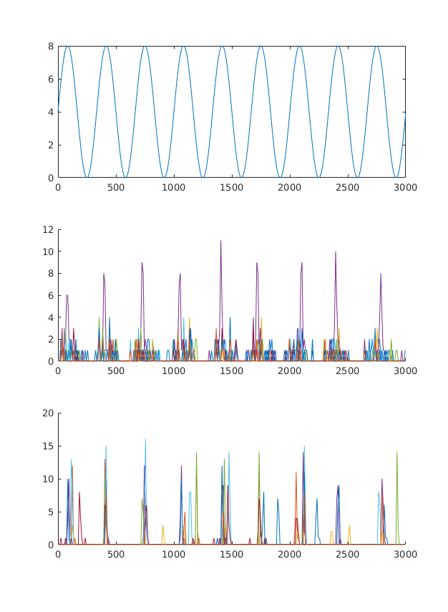
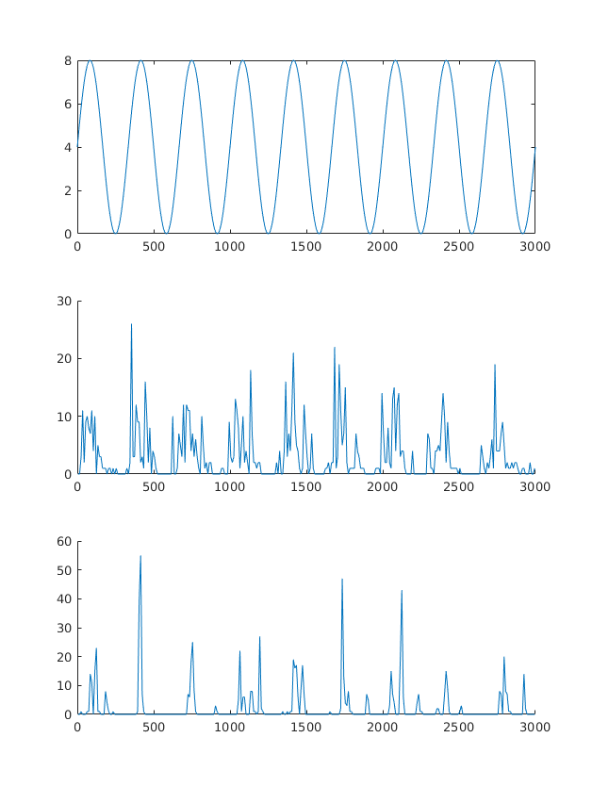
Results: Firing rate encoding + noise, disconnected columns
Top box shows input firing rate
INPUT layer firing rates, all 9 columns plotted using 9 colors
OUTPUT layer firing rates, all 9 columns plotted using 9 colors
Disconnected columns don’t reliably transmit information about input firing rate.
TODO: Make single slide from these 2 slides, improve presentation of results

Slide 18
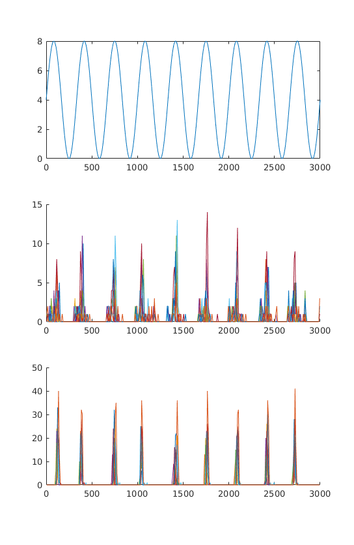
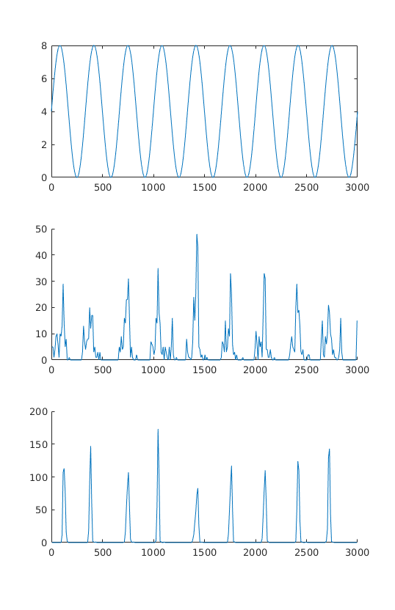
Results: Firing rate encoding + noise, weakly connected columns
Top box shows input firing rate
INPUT layer firing rates, all 9 columns plotted using 9 colors
OUTPUT layer firing rates, all 9 columns plotted using 9 colors
Weakly connected columns DO reliably transmit information about input firing rate.
Ensemble appears to filter the signal, reducing noise.

Slide 19
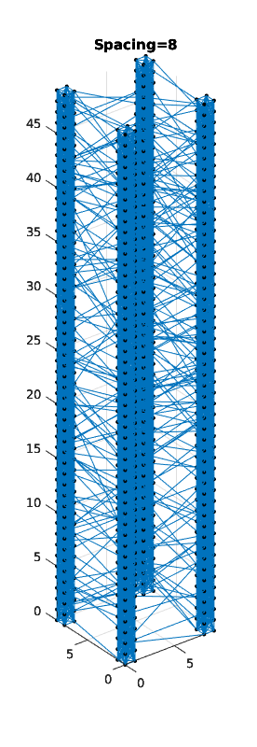
Column ensemble
Ensemble of 4 columns
Each constituent column is 4x4x50
Columns spaced 8 units apart
Strongly connected columns, weak interconnections
Stimulated bottom 4 layers with sine input
TODO: Include this older information about frequency dependence? If we keep this concept should perform the same experiment with population firing rate instead of just sine stimulus

Slide 20
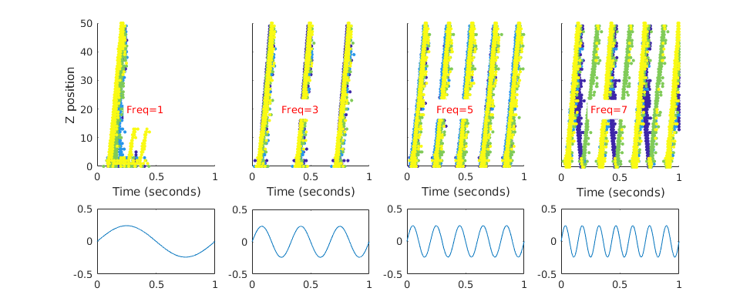
Frequency dependence
At very low frequencies each cycle can produce one or multiple waves
At medium frequencies each cycle produces one wave
At high frequencies output is complex
Connect to observed firing frequencies
Firing diagram, color-coded by column
Stimulus

Slide 21
2-D Initial Results
First experimental data

Slide 22
2-D simulations
Traveling wave patterns emerge from uniform random stimulus of a 2-D sheet
Due to wave annihilation we can observe “winner-take-all” wave initiation sites, resulting in a stable dynamic state
https://youtu.be/Is8vbyXliV0

